Slide 1
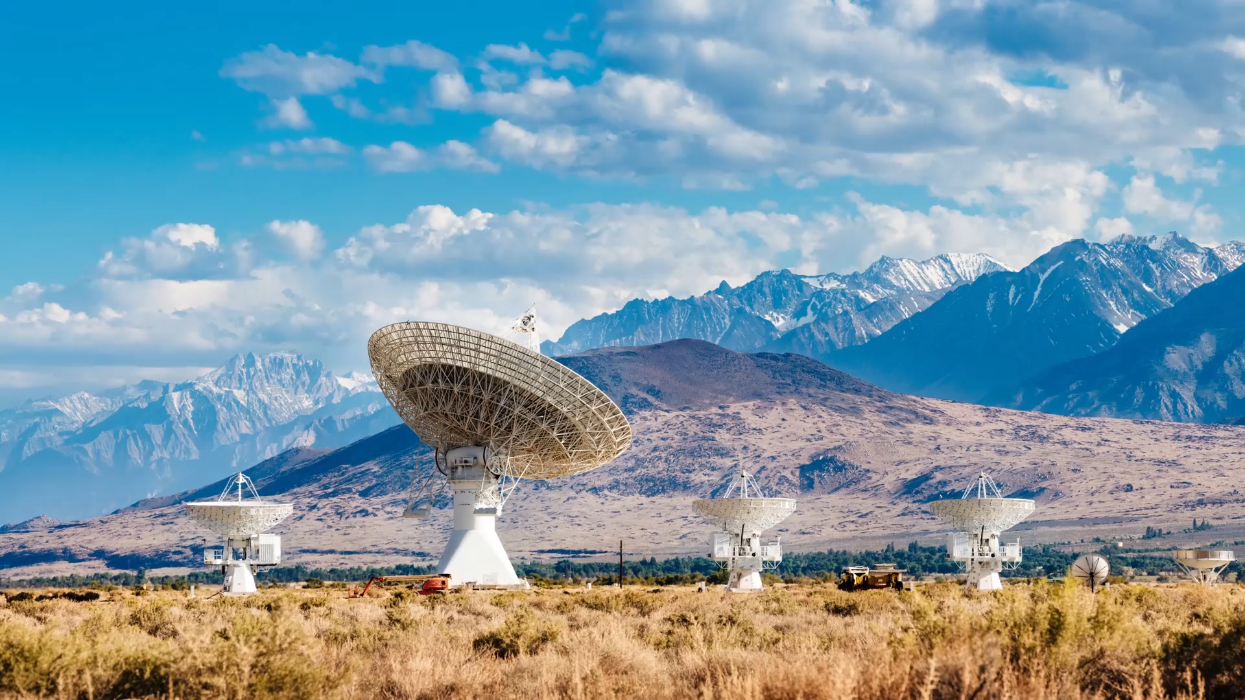
Ultrasonic Radar using Arduino with MATLAB.
By:- Shivam Kumar
Vatsal Agarwal

Slide 2
Introduction:-
It can detect any object in the path with the help of an ultrasonic sensor. Ultrasonic sensors rotate over the servo motor and almost cover all directions in rotatory motion. it uses in distance measuring and object detection. Radar system using the ultrasonic sensor to detect the object in front of the sensor. and servo motor help to cover the distance by rotating itself slowly

Slide 3
Components Required:-
Arduino Uno
Servo motor
Processing Software
Breadboard
Jumper wire
Arduino cable
Ultrasonic sensor

Slide 4
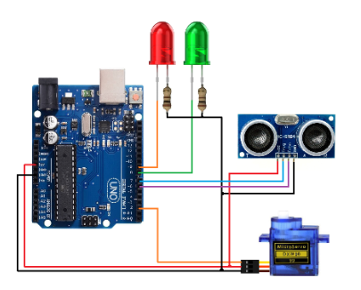
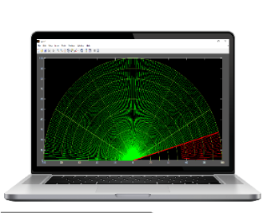
Arduino Radar circuit diagram:-

Slide 5
Matlab code:
clc;
clear all;
%Customize graph
figure('units','normalized','outerposition',[0 0 1 1]);
whitebg('black');
%Draw Scale Data
th = linspace(0,pi,1000);
R = 10:10:100;
for i=1:length(R);
x = R(i)*cos(th);
y = R(i)*sin(th);
plot(x,y,'Color', [0.603922 , 0.803922 , 0.196078] ,'LineWidth',1);
hold on;
end
%Draw Axis data
x0 = [0 100 0 0 0 0 ]; x1 = [0 100 86.60 50 -50 -86.60]; y0 = [0 0 0 0 0 0]; y1 = [100 0 50 86.60 86.60 50];

Slide 6
for i=1:length(x0);
hold on;
plot([x0(i),x1(i)],[y0(i),y1(i)] ,'Color', [0.603922 , 0.803922 , 0.196078],'LineWidth',2);
end
%Draw Sonar default data
for i=1:180
hold on;
[x, y] = pol2cart(i*0.0174532925, 100);
h(i) = plot([0,x],[0,y],'g','LineWidth',1);
end
%define serial port
s1 = serial('COM7');
s1.BaudRate=9600;
fopen(s1);

Slide 7
%Draw Sonar Data
while(1)
data = fscanf(s1);
[th, r] = strtok(data);
th = real(str2num(th));
r = str2num(r);
set(h(th),'color','r');
[x0, y0] = pol2cart(th*0.0174532925, 100);
[x, y] = pol2cart(th*0.0174532925, r);
set(h(th),'XData',[x0,x]);
set(h(th),'YData',[y0,y]);
m = plot([0,x0],[0,y0],'r','LineWidth',3);
drawnow
delete(m);
end

Slide 8
Arduino code:
#include <Servo.h>
Servo myservo;
#define echo 6 //Echo pin
#define trigger 7 //Trigger pin
#define G_led 8 // choose the pin for the Green Led
#define R_led 9 // choose the pin for the Red Led
int distance;
int degree;
void setup() { // put your setup code here, to run once
Serial.begin(9600);
myservo.attach(2); // declare Servo Motor as output

Slide 9
pinMode(echo, INPUT );// declare ultrasonic sensor Echo pin as input
pinMode(trigger, OUTPUT); // declare ultrasonic sensor Trigger pin as Output
pinMode(R_led,OUTPUT); // declare Red LED as output
pinMode(G_led,OUTPUT); // declare Green LED as output
delay(100);
}
void loop() {
for(degree=1; degree<180; degree+=1){
myservo.write(degree);
delay(80);
data();
}

Slide 10
}
void data(){
digitalWrite(trigger, LOW);
delayMicroseconds(2);
digitalWrite(trigger, HIGH);
delayMicroseconds(10);
long time = pulseIn(echo, HIGH);
distance = time / 28.5 / 2;
if(distance>100){distance = 100;}
if(distance>50){
digitalWrite(G_led, HIGH); // LED Turn On
digitalWrite(R_led, LOW); // LED Turn Off
}else{
digitalWrite(G_led, LOW); // LED Turn Off
digitalWrite(R_led, HIGH); // LED Turn On
}
Serial.print(degree); Serial.print( " "); Serial.println(distance);
}

Slide 11
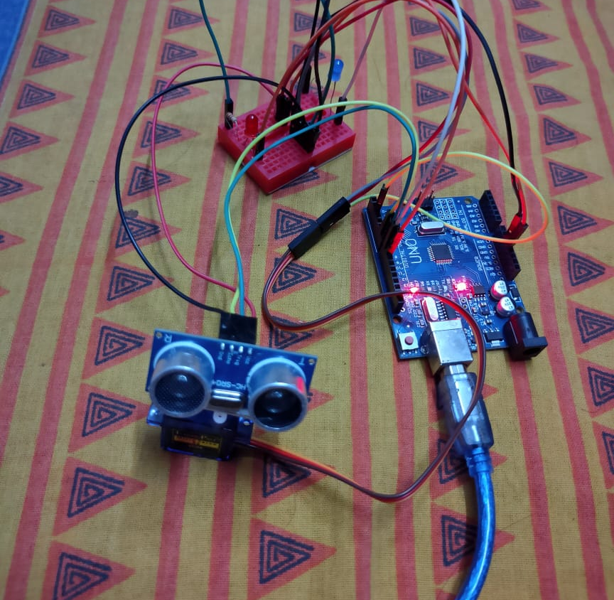
Working model:

Slide 12
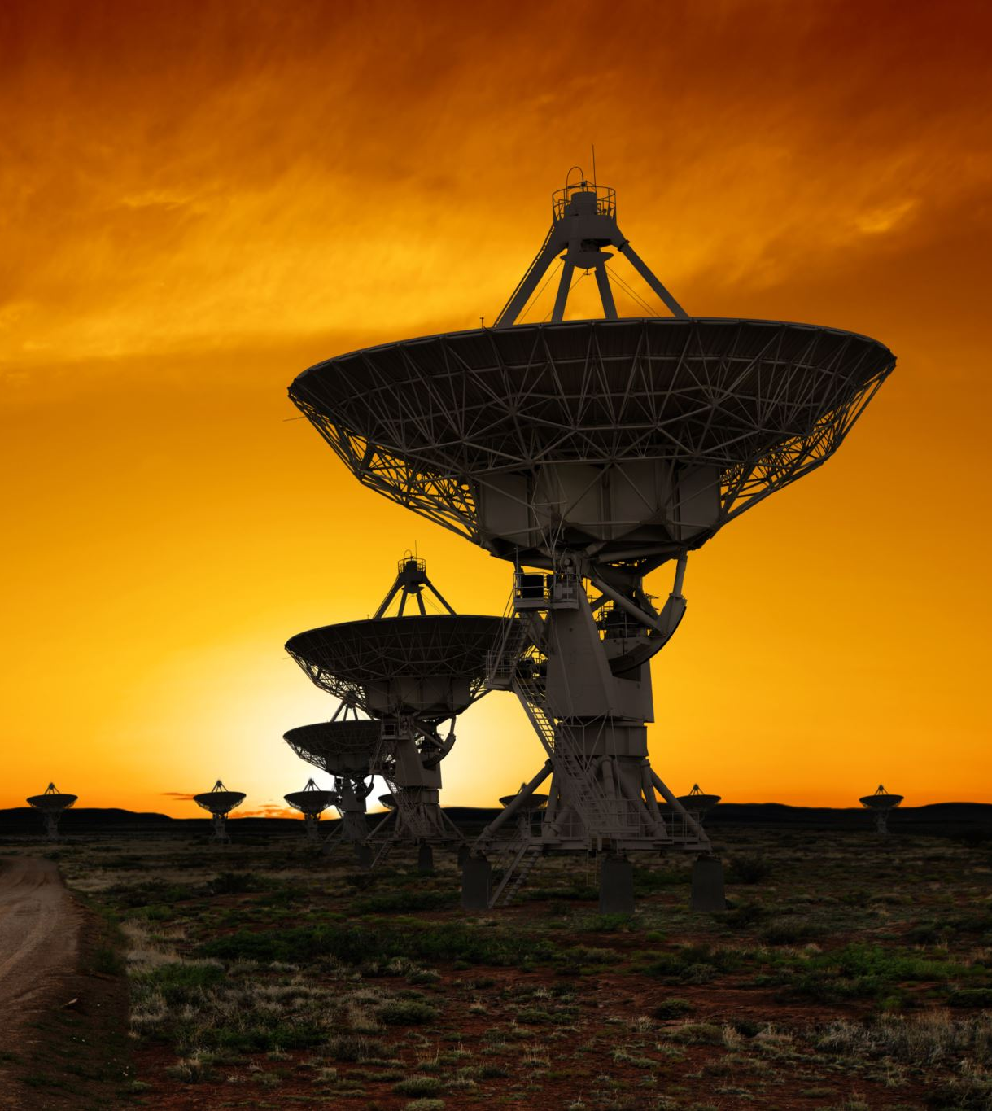
Applications of radar:-
Military
Law enforcement
Space
Remote sensing of environment
Aircraft navigation

Slide 13

Thank you

